Slide 1
Eenie Meenie Miney Macro
Tips on When to Use Which Macro Type
Jarrod Thuener
Sr. Product Manager, Workflow Integrations

Slide 2

Macro Overview
Iterative – Next Closest Location
Standard Macro
Summary & Tips
Batch Macro – GroupBy

Slide 3
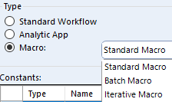
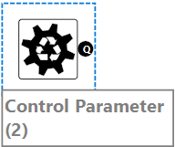
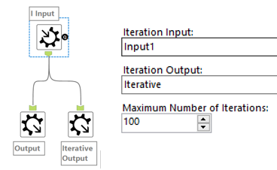
What are the types of Macros?
Standard Macro is any reusable set of tools
any number of inputs/outputs
can use interface tools for updating variables
can map to incoming fields
Batch Macro – reusable set of tools that run 1 time for each parameter passed through
Iterative Macro – reusable set of tools that run iterations until it runs out of records.
Notes:
A standard macro is any set of reusable tools. It can be as simple as a pass-through tool that manipulates data as is, or it can contain several inputs and outputs to combine and split data.
With the inclusion of interface tools, you gain the ability to update variables within the process or map incoming fields to new field names. This flexibility allows you to tailor the macro to your specific needs.
Building upon this idea, the batch macro extends the concept further by running the same process for each category or batch of records, which is determined by the control parameter.
This enables efficient handling of different groups of data, improving scalability and reducing manual effort.
On the other hand, the iterative macro takes repetition to the next level.
It continuously runs the same set of data through a process until either it runs out of records or reaches a pre-determined limit.
This type of macro is useful when you need to iteratively refine or transform data, taking into account the evolving state of the output at each iteration.
For those of you with a programming background, you can think of batch macros as the equivalent of a "for loop" and iterative macros as the equivalent of a "while loop."

Slide 4
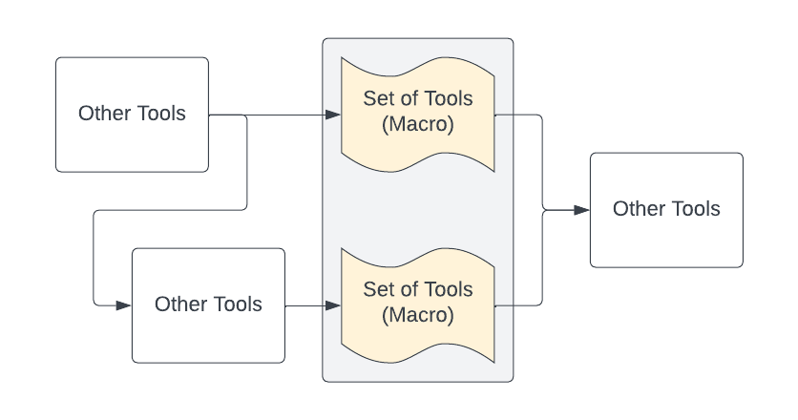
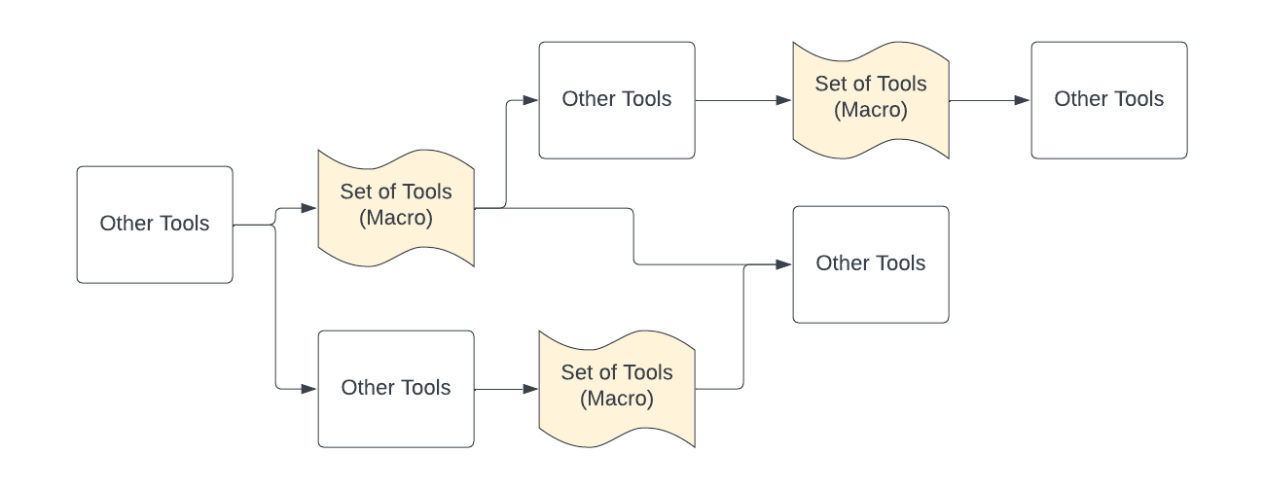
Pattern Identification – Standard Macro
Notes:
Let's begin by exploring the standard macro. This type is the most straightforward among the three.
Here is a diagram of how a workflow may be designed. The tan icons are sets of tools that perform a specific task. This could be a tool or two or it could be thousands of tools.
When you need to replicate that process in another workflow or within the same workflow, instead of copying the tools repeatedly, you can package them as a macro.
This saves time and allows for easy sharing with other users.

Slide 5
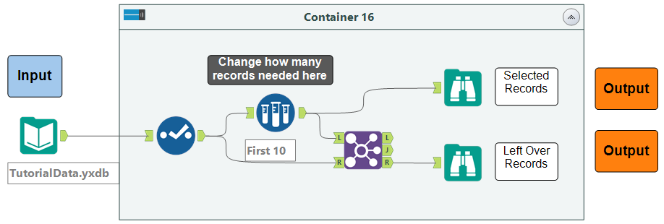
Standard Macro
In Workflow (Container is “Macro”)
Notes:
Here's an example to illustrate this concept. The workflow samples 10 records which you can see at the browse on top and creates a leftover pile, which is the browse on the bottom.

Slide 6
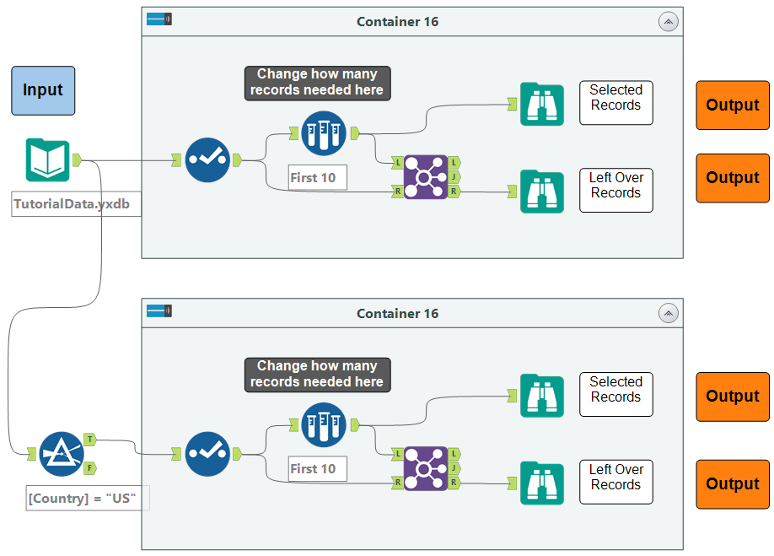
Standard Macro
In Workflow (Container is “Macro”) - Copy/Paste to reuse – Change sample manually
Notes:
When we want to reuse this process, we could copy the container and paste into different areas of the workflow. This takes up a fair amount of real estate on the canvas, so let’s condense it into a macro.

Slide 7
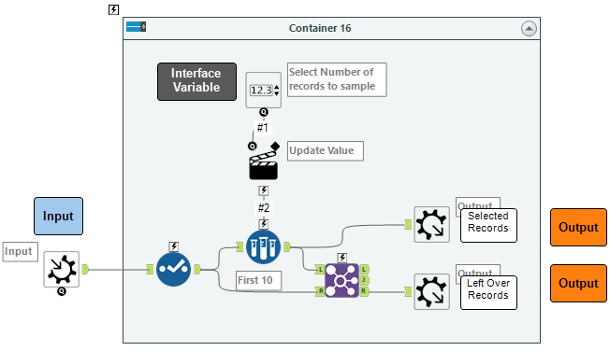
Standard Macro
As a Macro
Notes:
While the example used a fixed sample size, when we reuse this process, we want the ability to change that value.
To do this, we add an interface tool that enables users to change the sample size by modifying the sample tool values through the action tool.
On the left, the input tool becomes a macro input.
On the right, the browse tools become macro outputs.

Slide 8
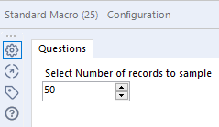
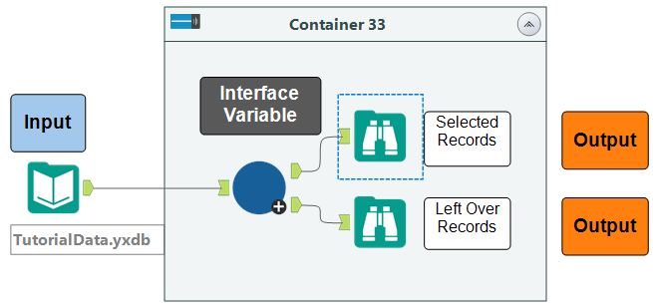
Standard Macro
Macro within the workflow
Notes:
Now, we have a single macro that allows us to directly modify the desired sample size. Our example was just a few tools, but macros can be hundreds or thousands of tools that represent a repeatable process.

Slide 9
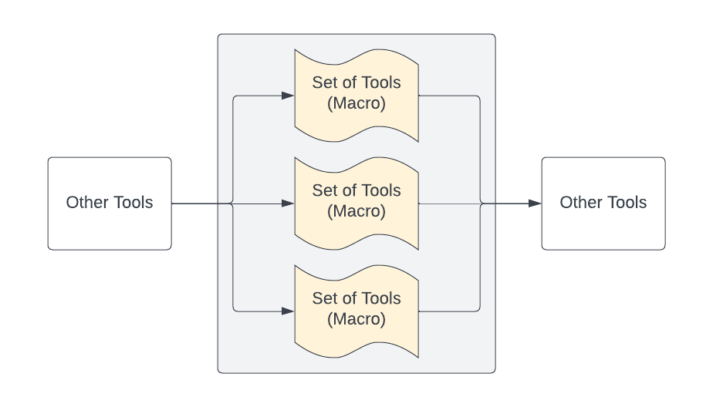
Pattern Identification – Batch Macro
Notes:
Batching is a fundamental technique for scaling your processes.
In this scenario, you have the same set of tools, but you want to apply them to each group of records individually.
Imagine if you had more than three groups, say, 30 or even 3,000. Managing them individually becomes challenging.

Slide 10
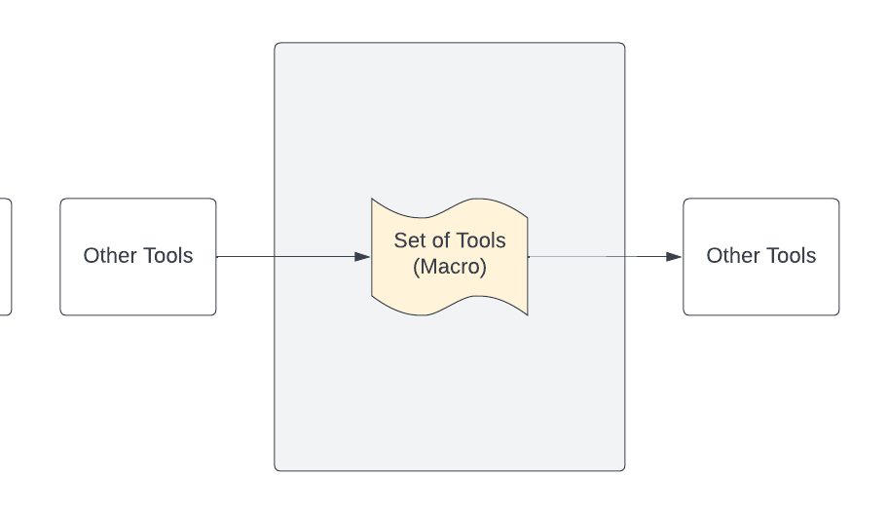
Pattern Identification – Batch Macro
Notes:
However, with a batch macro, it only takes one tool.
Within the batch macro settings, you can select a field to group the process.

Slide 11
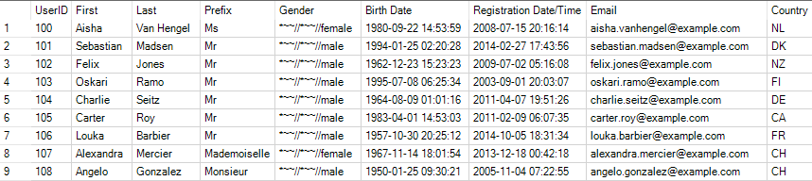
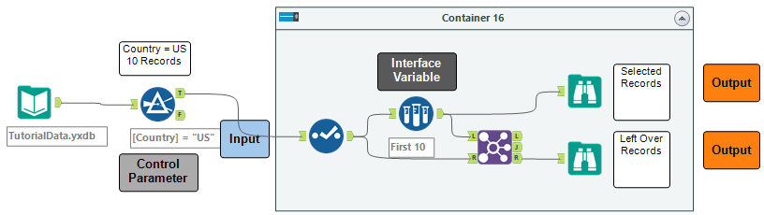
Batch Macro – Group By Problem
Scenario: We want to pull different number of records per country.
Notes:
In the example displayed, we are dealing with registration data that includes country abbreviations. Our goal is to extract the first ten records for each country.

Slide 12
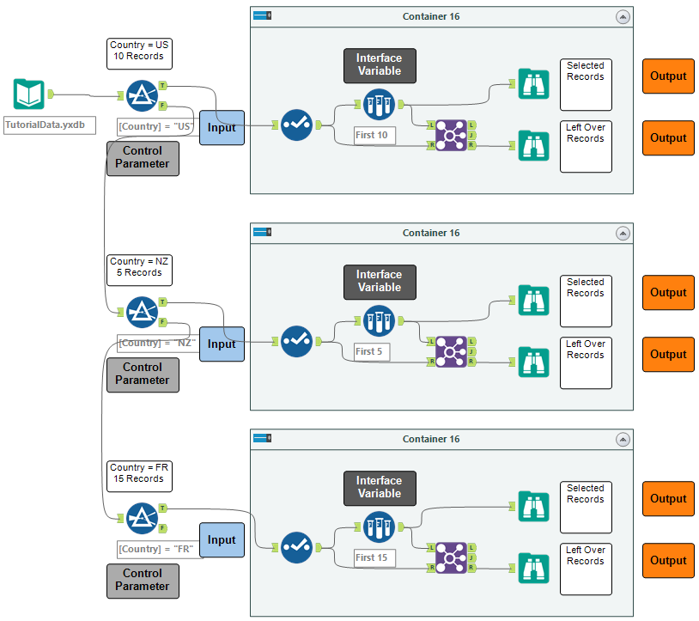
Batch Macro – Group By Problem
In Workflow – Copy and change sample size for each country
Notes:
Taking it a step further, let’s assume we want to choose a different sample size for each country.
In a standard macro, we would need to update each tool after filtering out the necessary data. That’s not reasonable when you have 3,000 groups to process.
It’s important to note here that the process is still the same for each country, but we want to change a variable within that process for each group.
Let’s take a look at how we need to set this up.

Slide 13
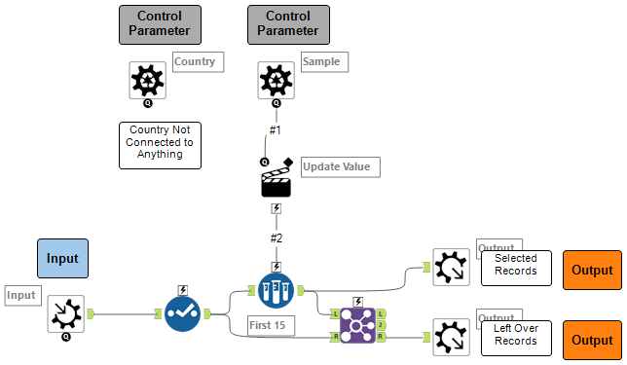
Batch Macro – Group By Problem
As a Macro
Notes:
While changing the sample size is typically an interface variable in a standard macro, in the batch macro, we can change the number for each country by changing it to a control parameter.
The control parameter isn’t connected to anything, but that’s ok, we’ll deal with that in the settings.

Slide 14
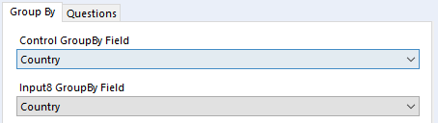
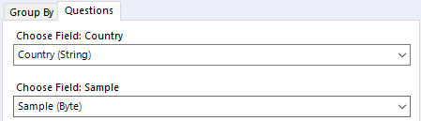
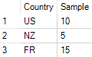
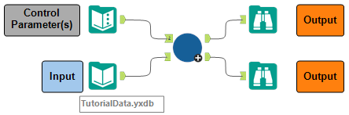
Batch Macro – Group By Problem
Macro within the workflow – Group by Country and Map the input fields
Notes:
The text input tool in the upper left contains 3 rows of countries and related sample values.
The input is our registration data with country abbreviations.
The setup here is to select the Country as the field to group by in both inputs. The questions tab allows the user to map their input fields.
The macro will process the control parameters one row at a time and apply the sample value to each country being processed. Simultaneously, because we used the group by tab, it will filter the input file by the country abbreviation. The end result is a set of records in the top output that consists of up to ten records for the US, five for New Zealand, and fifteen for France.
We are using 3 records here, but this could be thousands of batches being processed.

Slide 15
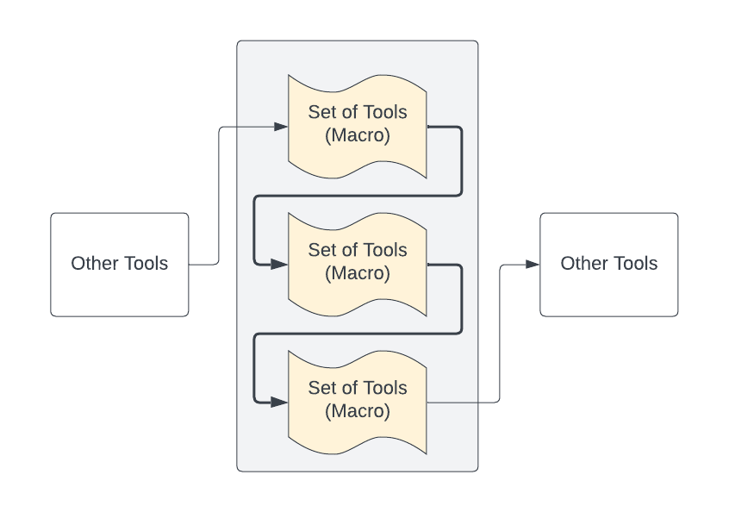
Pattern Identification – Iterative Macro
Notes:
Moving on to the iterative macro, this type can be a bit tricky to grasp. It is used when you need to repeatedly run records through the same process, but each iteration depends on the new state of the output. While it is possible to use a generate rows or multi-row tool instead of an iterative macro in some cases, it becomes challenging when several variables change simultaneously.
Notice the dark connectors here – the data is flowing directly from one process to the input of the same process.

Slide 16
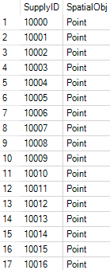
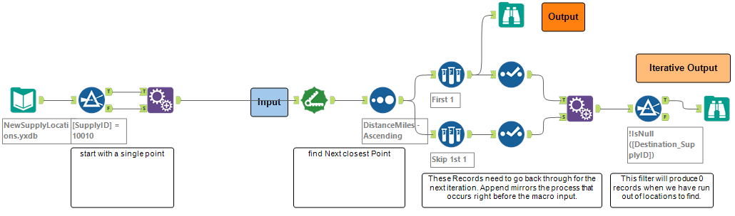
Iterative Macro – Next Closest Location
Scenario: We have a list of locations and need to find the order in which to visit
Notes:
In the example shown, we have a set of spatial objects representing supply locations, and our objective is to determine the order in which to visit these locations. We start with a single point, append all other points, and then find the next nearest location. When the process runs again, the starting point will be replaced with the second identified point, and so on.

Slide 17
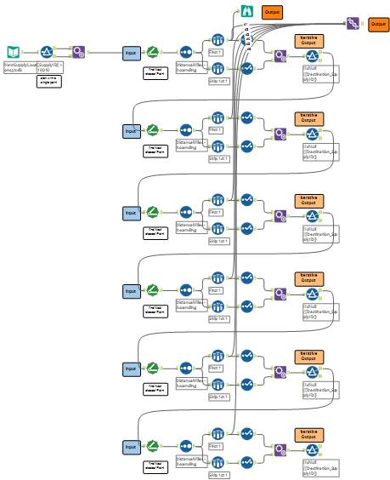
Iterative Macro – Next Closest Location
In Workflow – copy end-to-end for each location to find “Next” stop
Notes:
Connect the data from the Filter tool to the Distance tool end to end until we find our complete order of locations. This could be 100’s or 1000’s of times, so we can wrap this process up in an iterative macro so we can stop copying the process.
TIP – I usually setup my iterative macros so it looks like this. I copying the tools at least once and make sure the fields coming out of the iterative macro are the same going in.

Slide 18
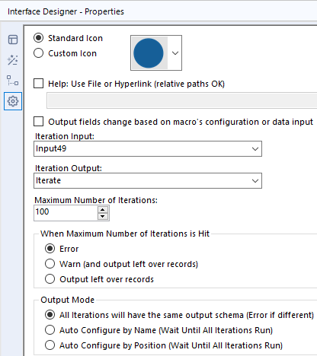
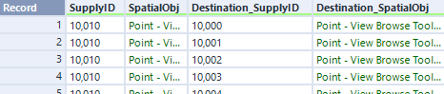
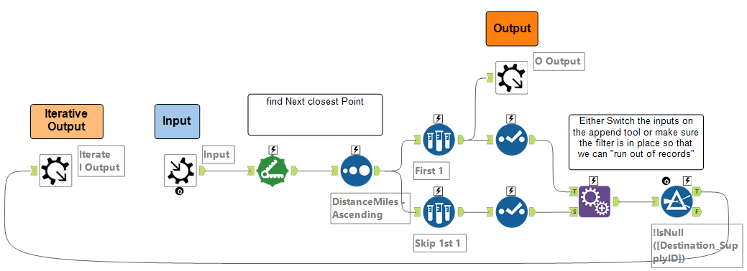
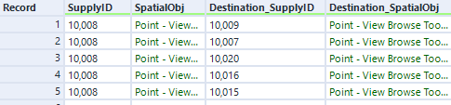
Iterative Macro – Next Closest Location
As a macro
Notes:
Here’s what the workflow looks like as we build the iterative macro.
Note the colors of the labels and that we are finding the next location, which then becomes our origin for the next “Iteration”
I only dragged the iterative output macro tool to the front of the process because visually, that is what is happening.
Make sure to set the input and output macro tools in the Interface designer.

Slide 19
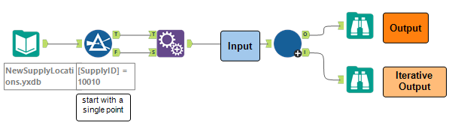
Iterative Macro – Next Closest Location
Macro within the workflow – Find all files using directory tool and Map the FullPath field
VS
Notes:
This macro will run as many times as we have locations to figure out the full list, in order.

Slide 20
Summary – When to use
Standard Macro
Batch Macro
Iterative Macro
Typically used when you have a process that can be applied to different fields but need to “re-map” to get it to work.
Need same set of tools in another workflow or somewhere else in the same workflow
Minor tweaks to settings – all records treated the same
Have a list of “versions” you want to run through a set process
You know the number of times you need to run (list of variables)
You want to modify a variable dynamically that isn’t controlled by “Input Connector”
Using “group by” function in a set of tools
Need to run a process several times in a row on the same dataset
You don’t know the number of times needed to run
Each “iteration” is dependent on the previous run’s output
Running API “paging” calls
Notes:
In conclusion, we have covered the three basic macro types: standard, batch, and iterative. The standard macro allows you to package a set of tools for reuse and sharing. The batch macro helps you scale your processes by applying the same set of tools to different groups of records. And the iterative macro is used when you need to repeatedly run records through a process, with each iteration dependent on the new state of the output.
By understanding these macro types and their applications, you can identify opportunities to optimize your workflows, save time, and enhance collaboration among users. 9:00

Slide 21
Summary – Identify the Pattern
Notes:
These design patterns are
Upper Left – Iterative
Upper Right – Standard
Bottom - Batch

Slide 22
Macro Usage Tips
Build a process and keep contained in a tool container. If you like the format of data coming in and going out, then you can copy out that container and save as a macro.
Start with the general workflow then add actions to the tools for customization.
Batch Macros – use “group by” option to auto-filter the input data stream.
Iterative macros – make sure the output macro tool that you are going to pass back to the input has the same fields and types as the macro input tool. **Use a union to check.**
Notes:
A few tips for building these out:
Explore the GitHub repo for the accompanying workflows.

Slide 23
Eenie Meenie Miney Macro
Tips on When to Use Which Macro Type
Jarrod Thuener
Sr. Product Manager, Workflow Integrations

